Slide 1


E-Exhibition
Proposed By
Team Vibhav

Slide 2


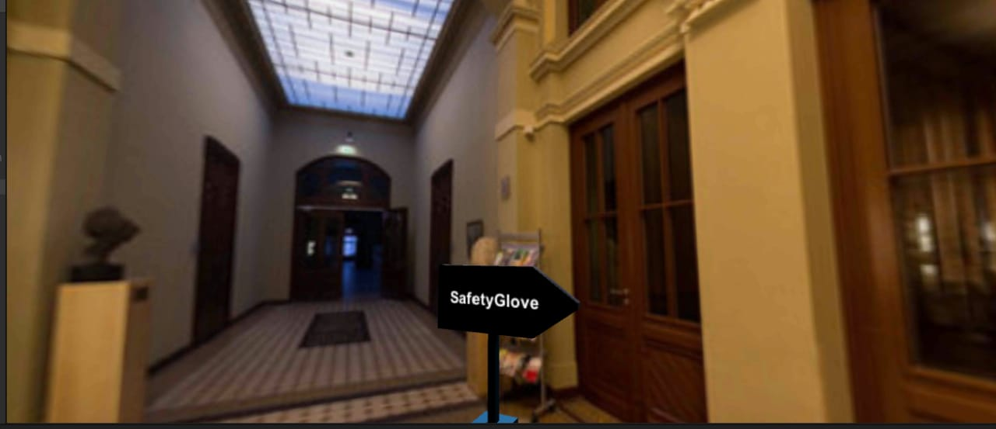
Overview:
Objectives
Problem the project solves
Solution to the problem
Techstack
Softwares used
Novelty of the project
Merits/Demerits
Business Aspects

Slide 3
Objectives
Our objective is to create an interactive virtual environment for the exhibition of various hardware projects by their 3D models and interaction with a question answering bot.

Slide 4
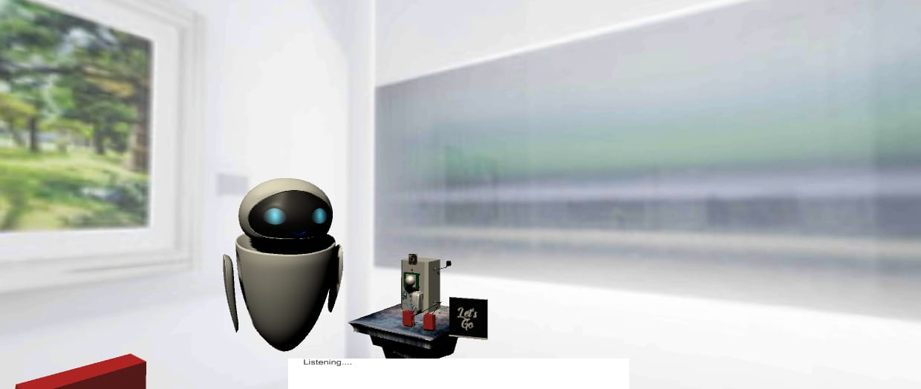
Problems the Project solves
● It is difficult to conduct an exhibition in this pandemic.
● Many good projects do not get much recognition.
●It is costly to organize an exhibition.

Slide 5
Solution to the Problem
The project involves use of virtual environment which solves the problem of conducting exhibition virtually.
Also this project provides a platform to showcase many other projects which didn’t receive much recognition.
It is a cost effective way to organize an exhibition.
It saves lots of time and space.
I

Slide 6
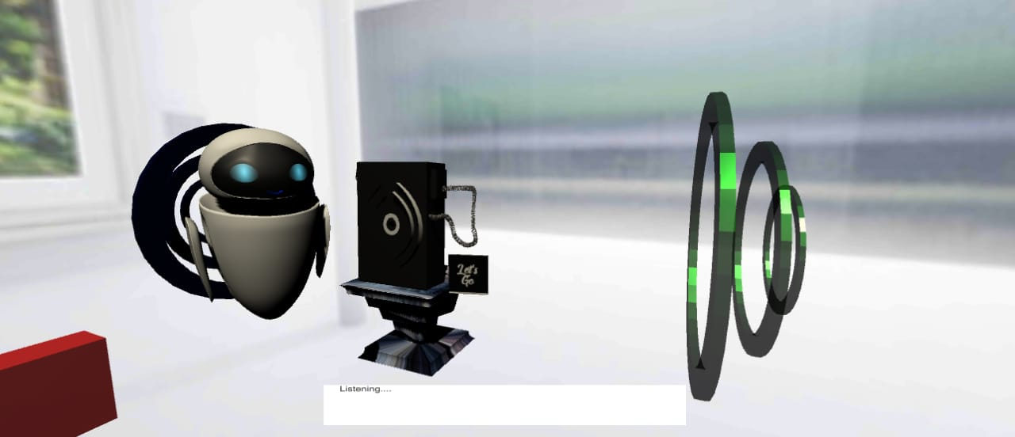
Techstack
Augmented Reality
Natural Language Processing
Cloud Technology

Slide 7
Novelty of the project
As due to the pandemic it is difficult to examine the hardware projects by seeing them in videos and images and with this we can see the 3D model of the projects and their workings.

Slide 8
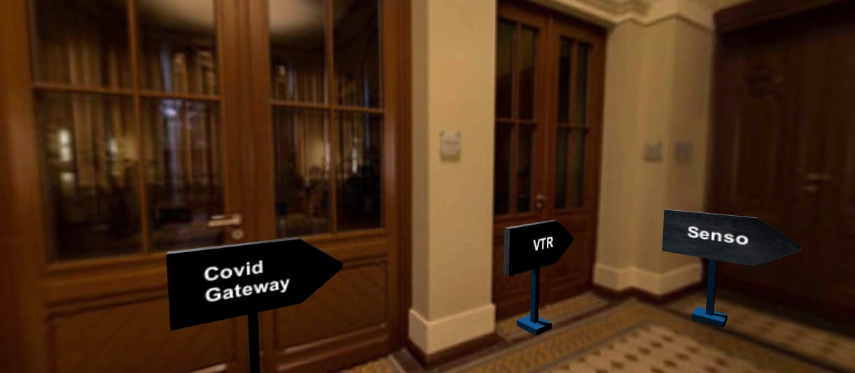
Softwares Used
Blender - It is used for 3D objects and virtual element creations and the models used in the project.
Unity - It is used for creating the virtual environment and graphic animations.
VS code - As all the codes are done in python and C# and VS code is used for programming.

Slide 9
Execution
We made 3D models of the projects using Blender. After that we created an environment of exhibition hall in Unity. Then we added texture to the models and added some animations to give a better idea about how the project works.
Also to make the user experience better we added a question answering bot to the project that will resolve the user's queries regarding the project using NLP.

Slide 10
Merits / Demerits
Merits:
It’ll provide easy visualization of the project in a personalized context. It’ll allow them a self-guided exploration in the field of AR .
Demerits:
Users watching the exhibition will be unable to interact with each other.

Slide 11
Business Aspects
This project can be used for displaying various projects virtually using 3D models in future.
Also the projects can be used for conducting exhibitions which will save time and space.
I

Slide 12
You can now ask any of the queries nudging your curious minds!

Slide 13


Team Vibhav
Thanks you for your time!

